Slide 1
Unit III Particles and Waves Mechanism of x-ray production (continuous and characteristic x-rays, Duane- Hunt limit), Compton effect, Pair production, Phase and group velocities, Uncertainty principle and its applications.

Slide 2
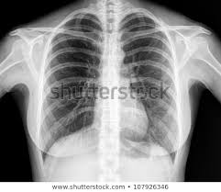
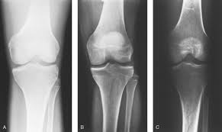

Slide 3
“Chance discoveries are the best discoveries”

Slide 4
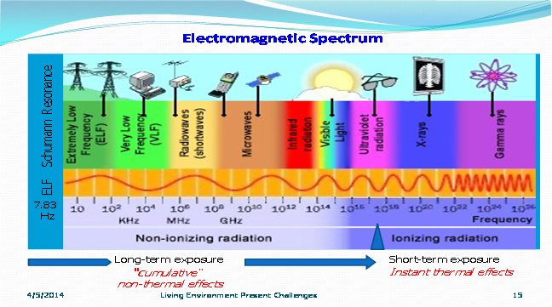

Slide 5
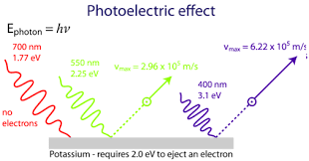

Slide 6
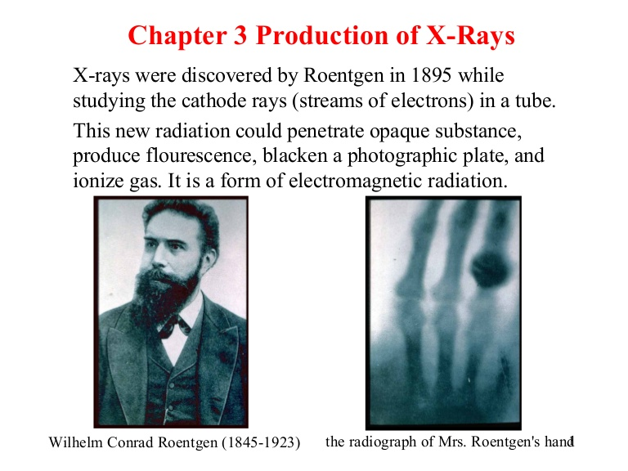

Slide 7
Properties of X-rays
Ranges from 0.1Å-100Å.
Electromagnetic wave v=c.
Not deviated by electric and magnetic field.
Affect the photographic plate very intensely.
They ionize the gas through which they pass.
Cause fluorescence (zinc sulphide, barium platino cyanide).
Cause photoelectric effect.
Travel in straight line, cast shadow.
Undergo reflection, refraction, interference, diffraction polarization.

Slide 8
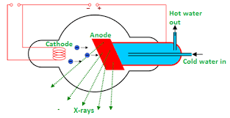

Slide 9
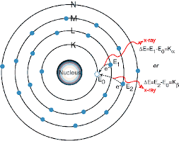
Characteristic and Continuous X-Rays
Characteristic X-Rays

Slide 10
Few of the fast moving electrons having velocity about one-tenth of the velocity of light may penetrate the surface atoms of the target material and knock out the tightly bound electrons even from the innermost shells like K, L or M etc of the atom.

Slide 11
The vacancy so created may be filled up by the electrons from higher shells i.e. electrons from higher shells jumps to fill up the created vacancies. This electronic transition takes place. The energy difference is radiated in the form of x-rays of very small but of definite wavelengths.

Slide 12
The wavelength depend upon target material.
Due to this fact these are known as characteristic x-rays.

Slide 13
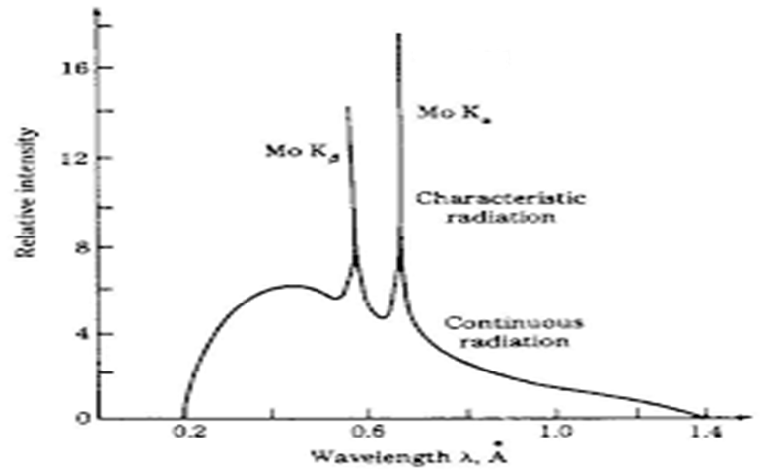

Slide 14
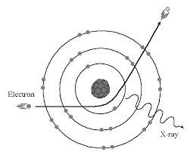
½ m v₂²
½ m v₂²
½ m v₁²

Slide 15
A few fast moving electrons penetrate deep into the interior of the atoms of the target and are attracted by the attractive forces of their nuclei. Due to these force, the electrons get deflected from their original paths.

Slide 16
In this way, the electrons are decelerated i.e. their velocity is reduced and this gives rise to loss of energy. The loss of energy during retardation is given off in the form of em radiation i.e. x-rays of continuously varying wavelengths.

Slide 17
The x-rays consist of continuous range of frequencies upto maximum frequency v_{max} or minimum wavelength λ_{min}. This is called a continuous spectrum.

Slide 18

Let the velocity of an electron changes from v₁ to v₂ due to deflection or due to collision. If m be the mass of electron, then the energy of the emitted photon due to the reduction in velocity is given by:

Slide 19

when the electron moves very close to the nucleus then it loses a greater amount of energy and consequently releases a photon of high frequency. Obviously when the electron is completely brought to rest by the forces, then the liberated photon has the maximum frequency. For this case

Slide 20

We know that the kinetic energy of an electron having charge e and accelerated by a potential V is given by:

Slide 21


From equations 2 and 3, we get

Slide 22

m

Slide 23

Duane-Hunt formula
λ_{min} does not depend upon the target material and is inversely proportional to the applied voltage V.
Å

Slide 24
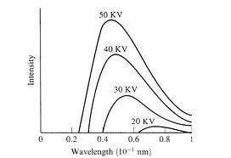

Slide 25
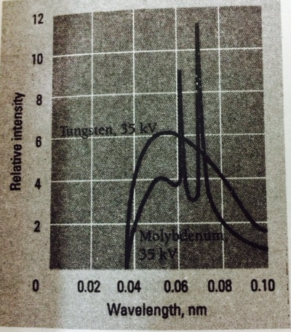

Slide 26
Q.1
Find the shortest wavelength and maximum frequency present in the radiation from an x-ray machine whose accelerating potential is 50,000 V.

Slide 27



Slide 28
Q 2
How much should be the voltage of x-ray tube be so that the electron emitted from cathode way give an x-ray of wavelength 1 Å.

Slide 29



Slide 30
Q 3
An x-ray tube works at 18 kV. Find the maximum speed of electron striking the target. m= 9*10⁻³¹ kg, e= 1.6*10⁻¹⁹ C

Slide 31




